Slide 1

PIT Tag Based Monitoring of Salmon Returns

Slide 2
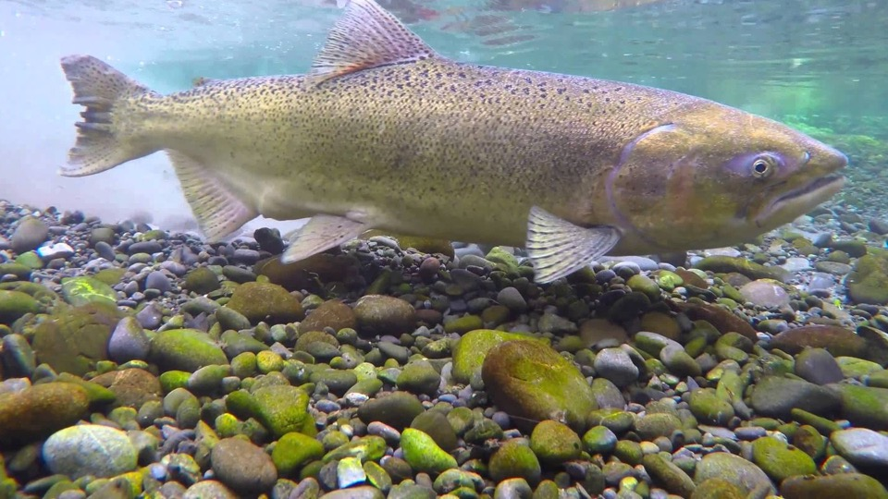
Objective
Estimate number of adult salmon returning to various detection points using PIT tag observations

Slide 3
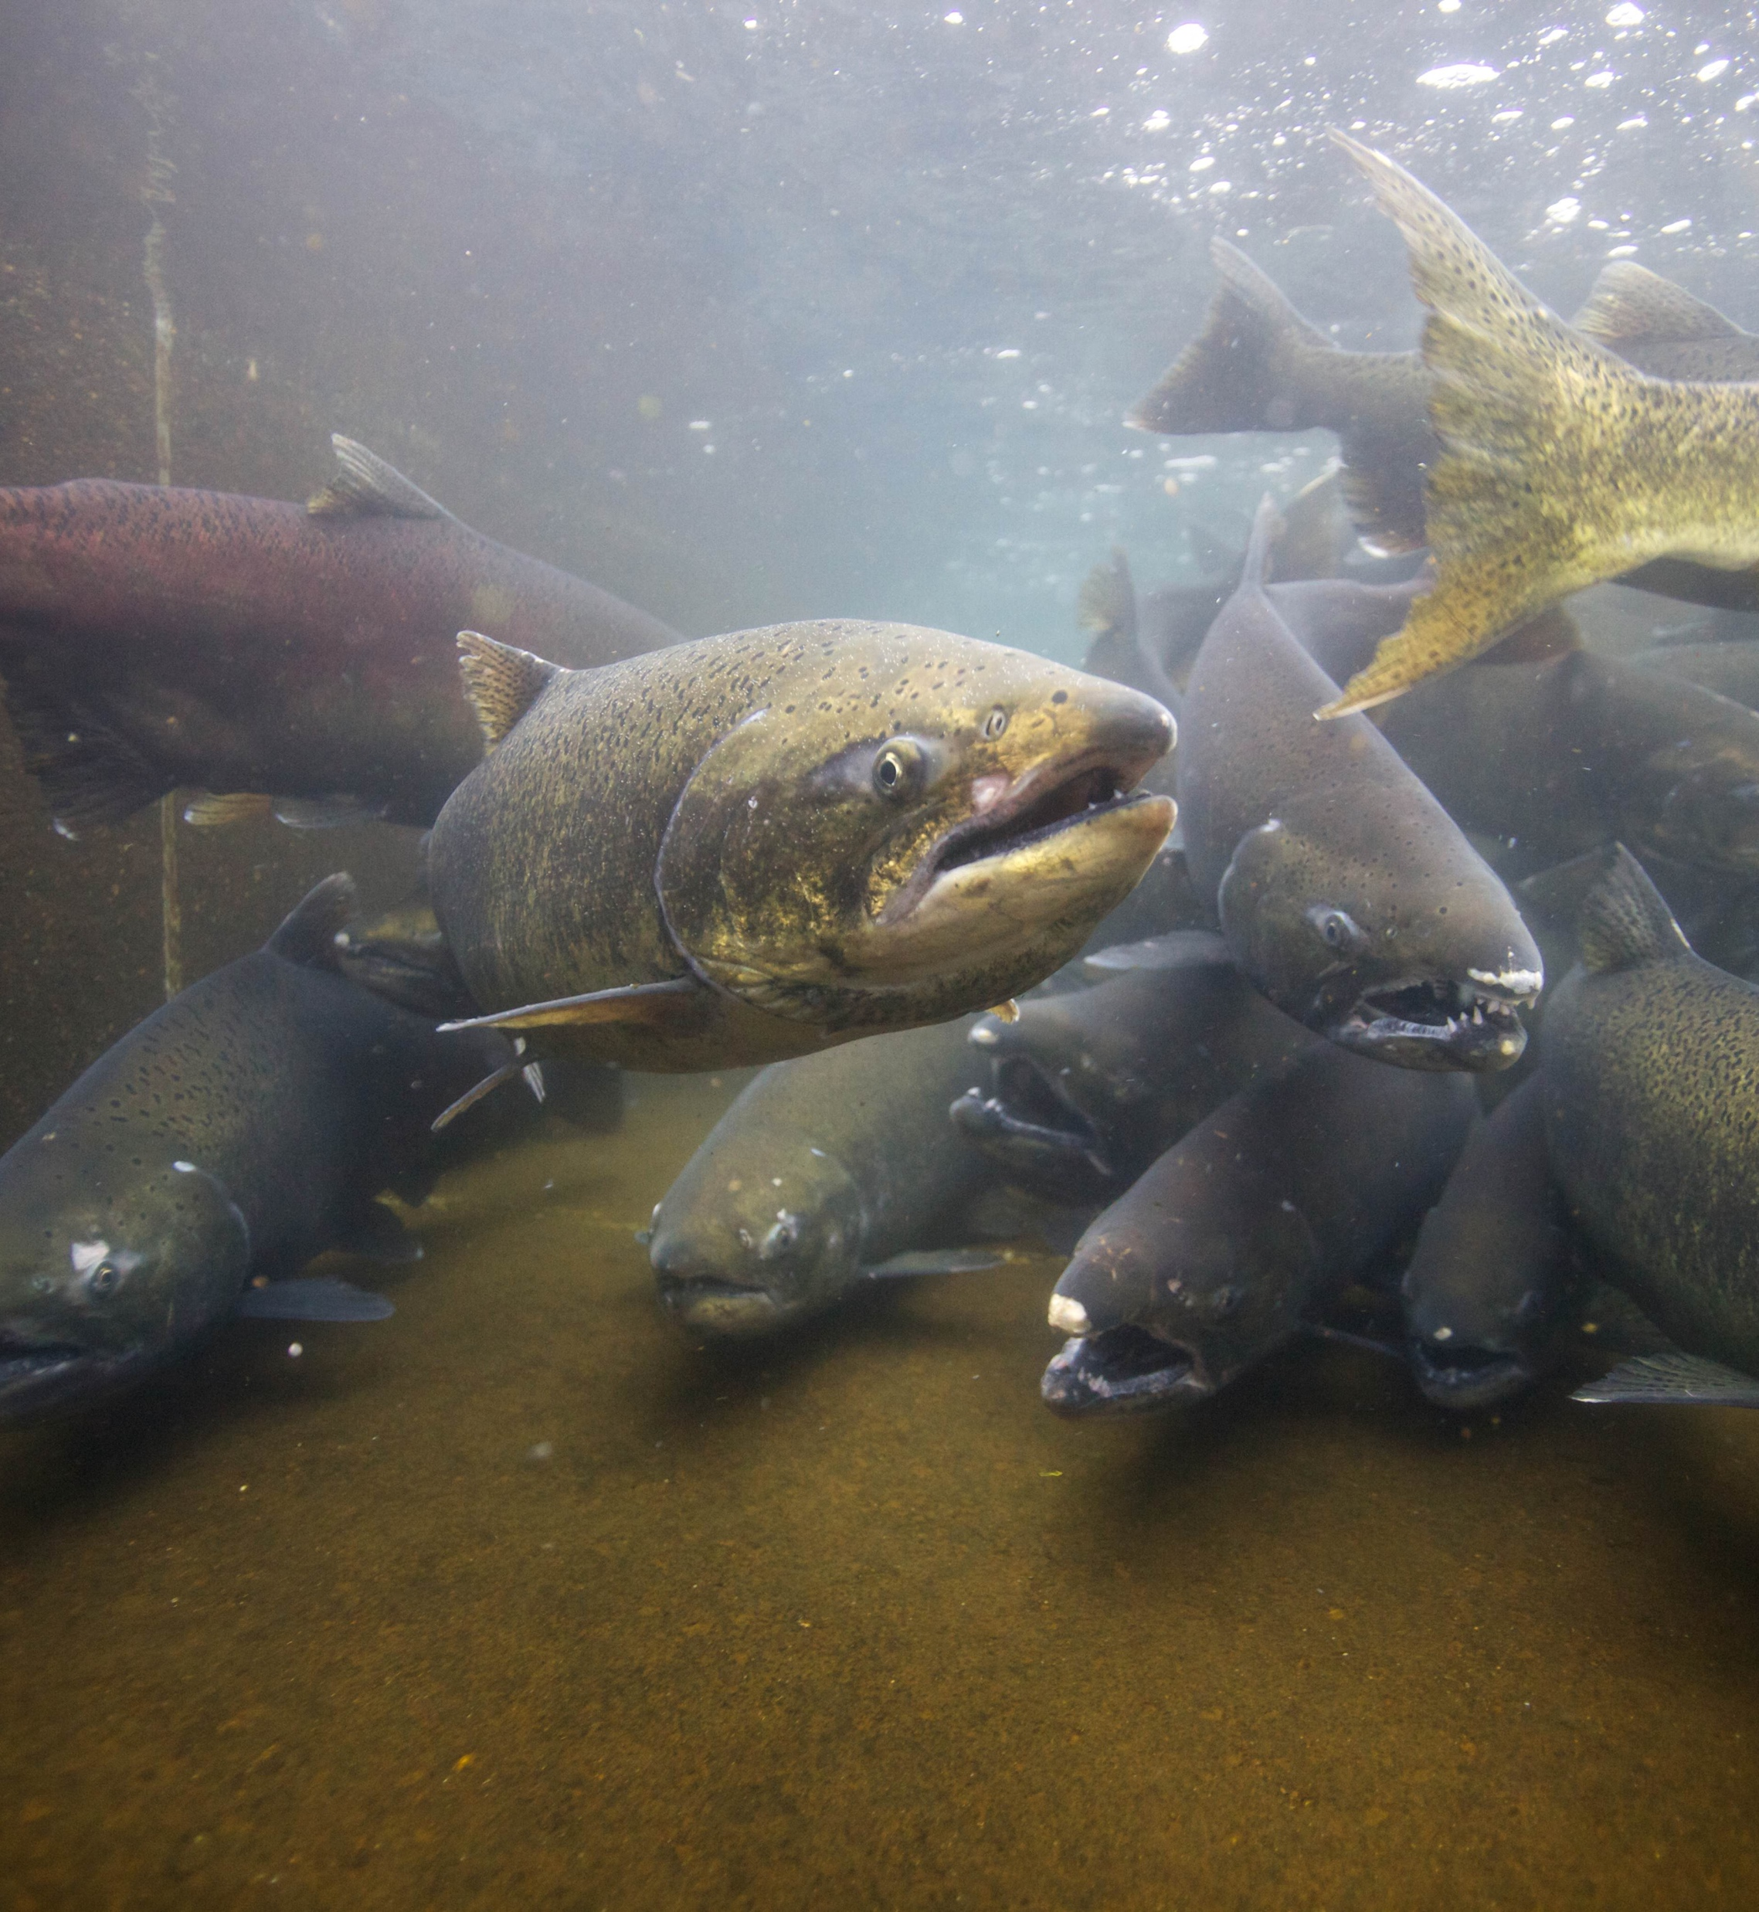
Outline
Data Requirements
Model Structure
Validation
Model Assumptions
Instructions

Slide 4
Data Requirements

Slide 5

Necessary Data
PIT-tagged fish
Random and representative sample of adult returns
~ 5-15% of the run?
Biological data
Detections of tags
Estimate of abundance somewhere within system

Slide 6
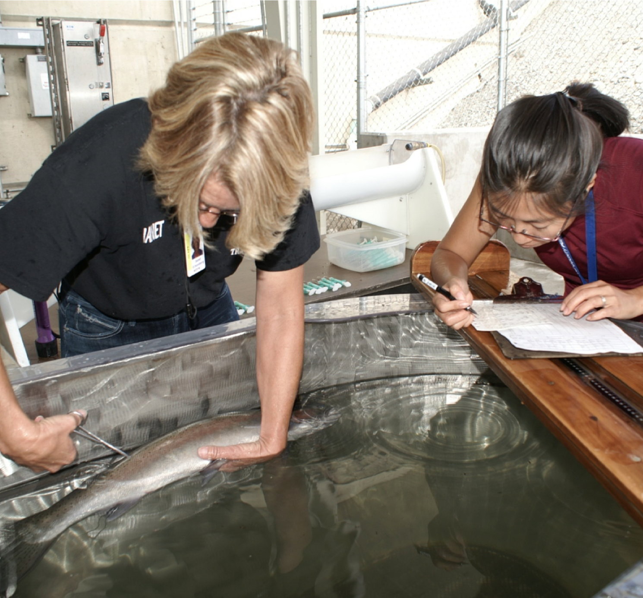
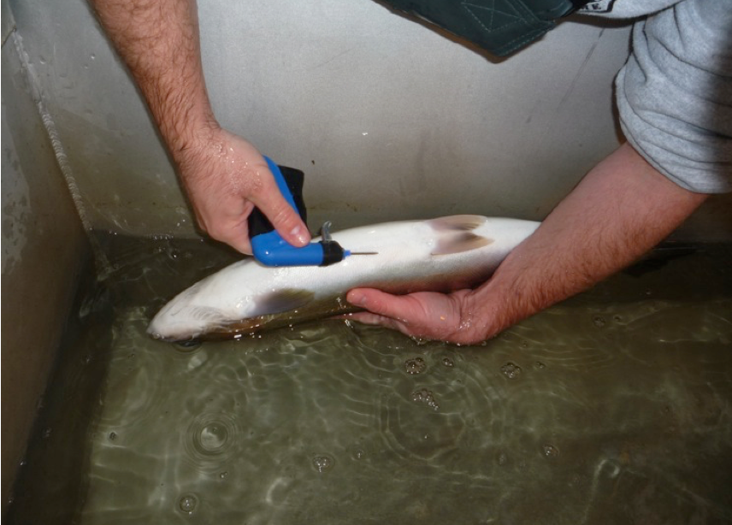
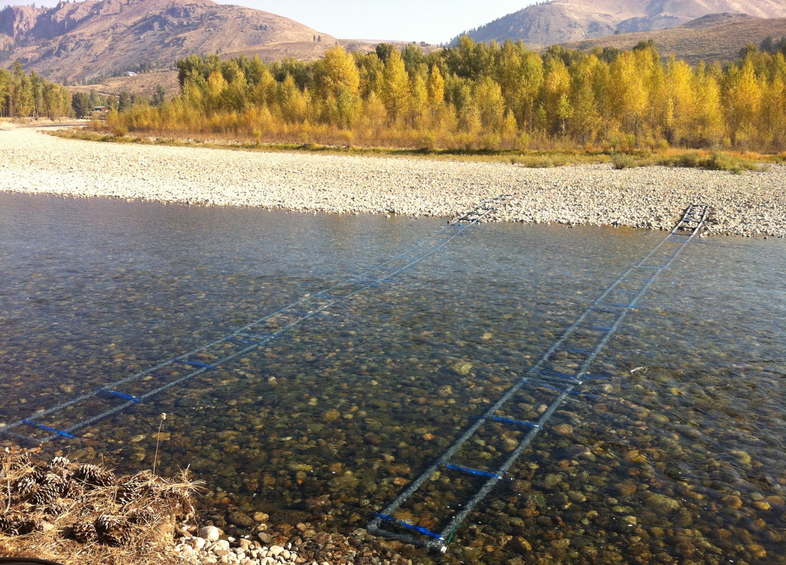
Fish are PIT tagged…
And re-sighted upstream
In the fish trap,

Slide 7
Notes:
Need information about which sites to include, and how they are placed on the landscape relative to one another.

Slide 8
Model Structure

Slide 9
Dam Adult Branch Occupancy Model
Double Arrays
Weir / Single Array

Slide 10
Dam Adult Branch Occupancy Model
Notes:
Branching network
Fish can “occupy” one of several ”patches” or “branches”

Slide 11
Dam Adult Branch Occupancy Model
E
Movement Probabilities (𝛹)
A B
A C
A D
A
C E
C
B
A➞E = (A➞C) × (C➞E)
D
A
Detection Probabilities (p)
Estimate: A, B, C, E
Fixed: D
Notes:
State-space framework: simultaneously estimate movement and detection probabilities
Use hatchery/wild fish together for detection, separate movement rates
Movement: Multinomial above A; binomial past E
Detection: informed by double array AND upstream detections.
Escapement: multiply movement by total escapement (e.g. at Prosser Dam)

Slide 12
Dam Adult Branch Occupancy Model
E
Capture Histories
A1 | A2 | B1 | B2 | C1 | C2 | D1 | E1 | E2
1 | 1 | 0 | 0 | 1 | 0 | 0 | 0 | 1
0 | 1 | 1 | 1 | 0 | 0 | 0 | 0 | 0
0 | 0 | 0 | 0 | 0 | 1 | 0 | 1 | 1
1 | 1 | 0 | 0 | 0 | 0 | 1 | 0 | 0
C
B
D
A
Notes:
Detections are turned into capture histories
Upstream detections can inform downstream detection probabilities

Slide 13
Model Benefits
Can use hatchery/wild tags together to estimate detection
Separately estimate movement probabilities
Potentially cost-effective compared to weirs and redd counts
Incorporates all uncertainty
Including in total escapement
Initial branches may have time-varying probabilities
Tagged fish may not be representative of run at large
Trap rate changes / shut down
Differential run timing
Escapement estimates on various spatial scales

Slide 14
Notes:
Methow population
OR
Twisp river

Slide 15
Biological Summaries
Notes:
Could also summarize age structure, length-at-age,

Slide 16
Validation

Slide 17
Comparison with Weirs
Notes:
Validation done in Snake basin
Not many places to validate steelhead in the upper Columbia

Slide 18
Comparison with Weirs

Slide 19
Model Limitations

Slide 20
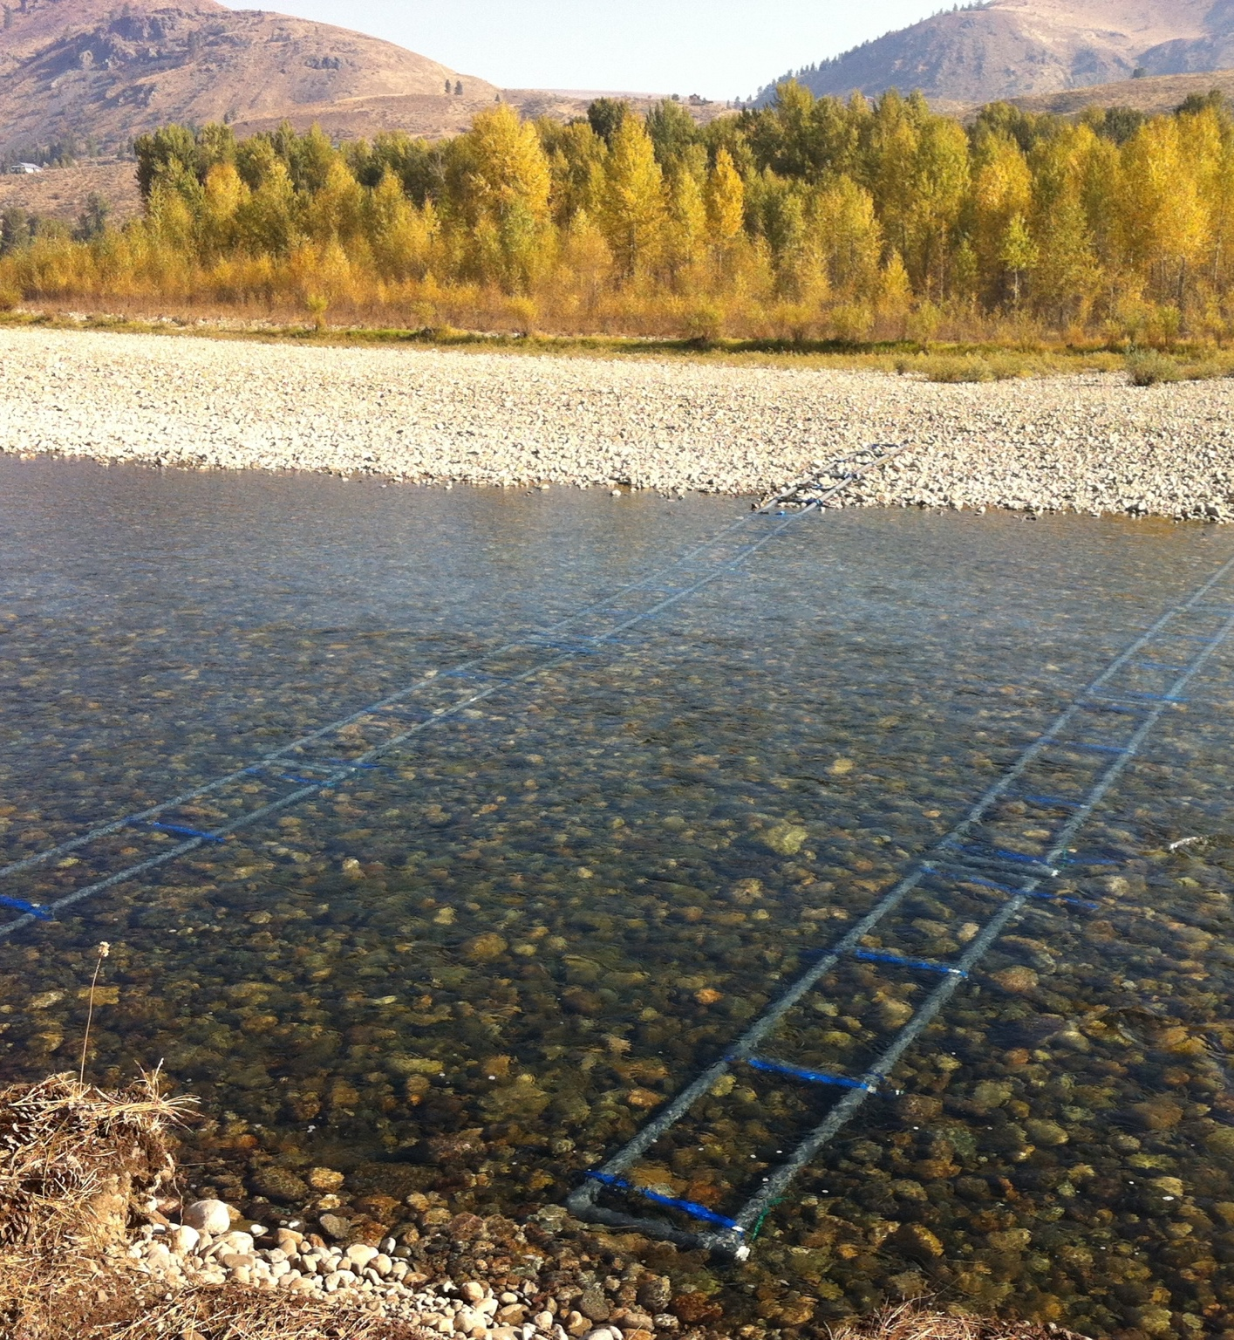
Model Assumptions
Tags are representative of run
Need sufficient number
Double arrays are independent
Helps if there is an upstream detection site
Fish are on a one-way trip
Detection histories must be cleaned
Assume final detection is spawning location
Detection probability is averaged across run season

Slide 21
Step-by-step

Slide 22



Modeling Steps
Step | Tool
List of tags
Biological data for each tag
Query detection histories | PTAGIS query
Clean detection histories | R - PITcleanr
Review detection histories | Excel
Prep data for DABOM | R - PITcleanr
Run DABOM | R – DABOM
Estimate total abundance at Prosser Dam | R – STADEM or ???
Combine movement and total abundance | R - DABOM
Summarize biological information | R - PITcleanr

Slide 23
Questions for Yakima Nation
How does the tagging operation work?
How consistent is it throughout the season?
What dates at Prosser constitute each return year?
How shall we generate abundance estimate at Prosser?
Or is there a better location within the system to get an abundance estimate?
What kind of biological data is available for each fish, other than origin?
What years would you like estimates for?
Is there a date after which detections shouldn’t count toward spawning locations? I.e. they must be kelts at that point?

Slide 24
Still accurate?
Sites not on PTAGIS:
TTN: isn’t operating yet, right? When will it be online?
MR+: not a site
Do you have list of tags detected in Marion drain?
WNS
TEAN
But do see NFTEAN, TEANAR, TEANMF, TEANWF
Any other PTAGIS detection codes that should be combined with any of these sites? (ROZ? SUN?)
Which ones are single arrays or weirs?

Slide 25
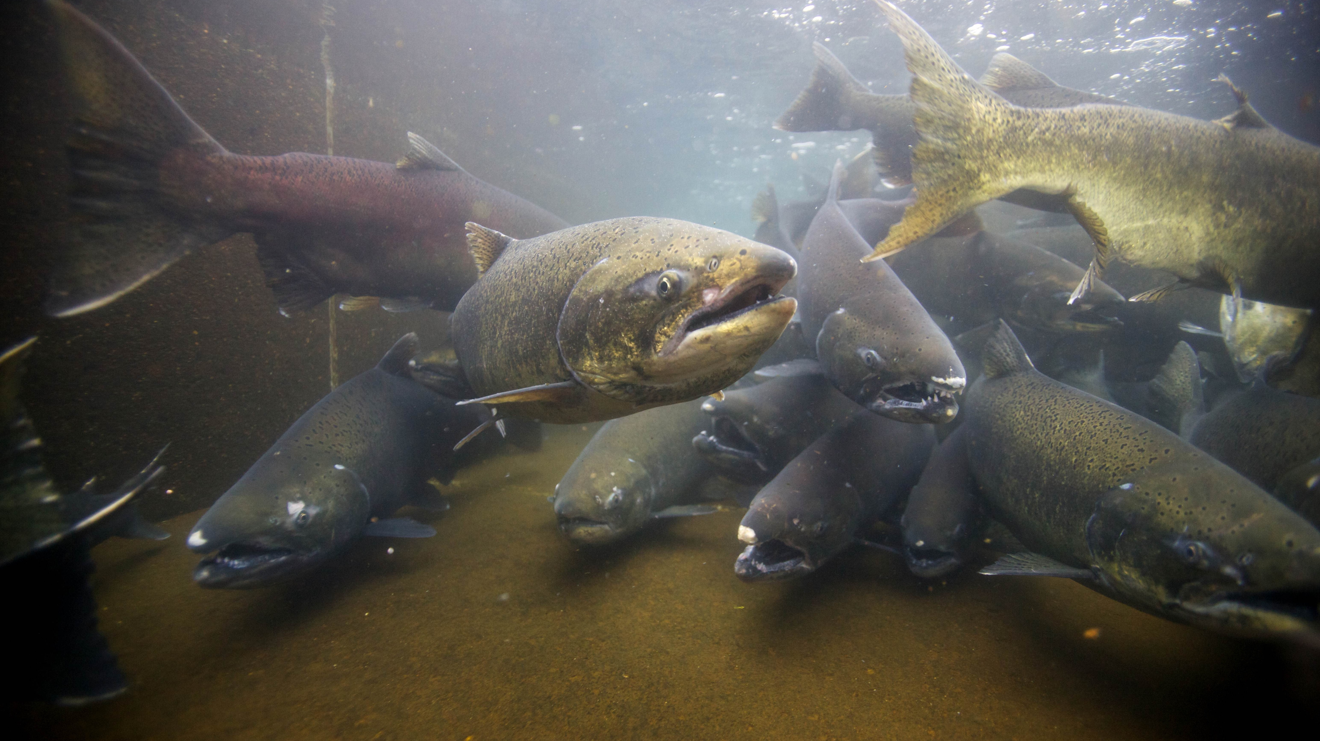
Questions?

Slide 27
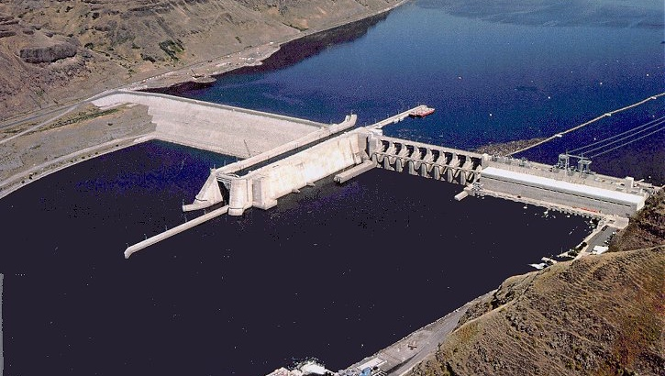
Unique Wild Escapement
Data Sources
Window Counts
Re-ascension Rate
Night Passage
Unique Escapement
PIT Tags
Total Escapement
Unique
Wild, Hatchery, HNC Escapement
Trap Rate
Fish Trap
Origin Proportions

